Slide 1
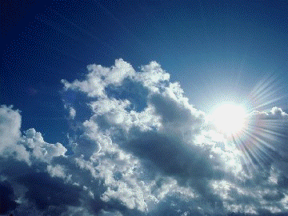
Unit 5 Week 2 Wonders- High Frequency Words
What can you see in the sky?

Slide 2
Chant the word as it appears
another
climb
great
full
poor
through

Slide 3
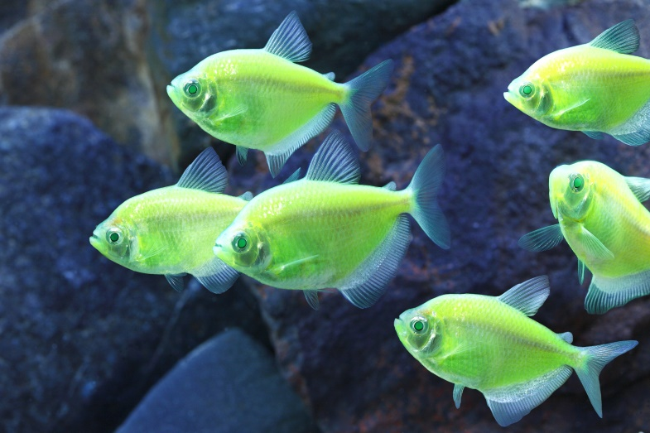
four large none only put round
I saw a ______ fish in the fish tank.
large

Slide 4
four large none only put round
Ted has one left, but Mark has _____.
none

Slide 5
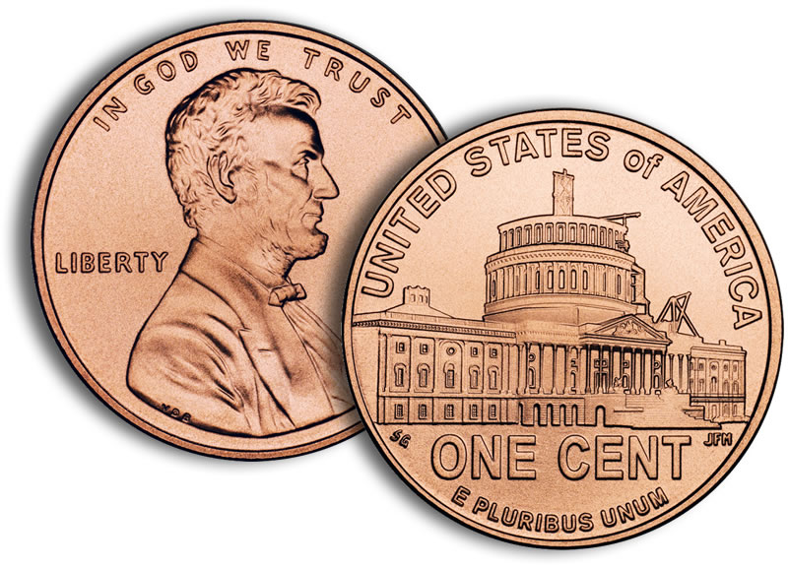
four large none only put round
A penny is ________.
round

Slide 6
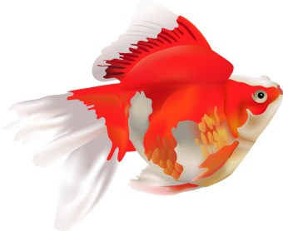
four large none only put round
I see _____ fish in the fish tank.
four

Slide 7
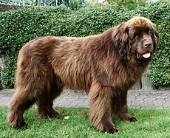
four large none only put round
large
I saw a ______ dog in the park.

Slide 8
four large none only put round
The card cost ______ five cents.
only

