Slide 1
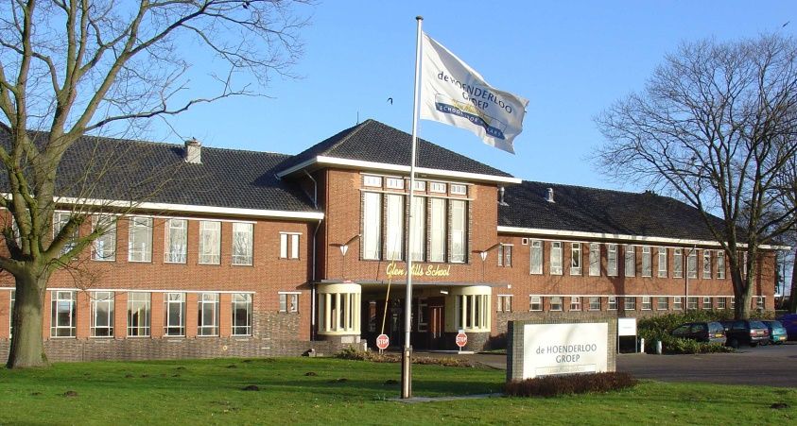
Unit 1 Week 1 Wonders- High Frequency Words
What do you do at your school?

Slide 2
Chant the word as it appears
does
school
not
what

Slide 3
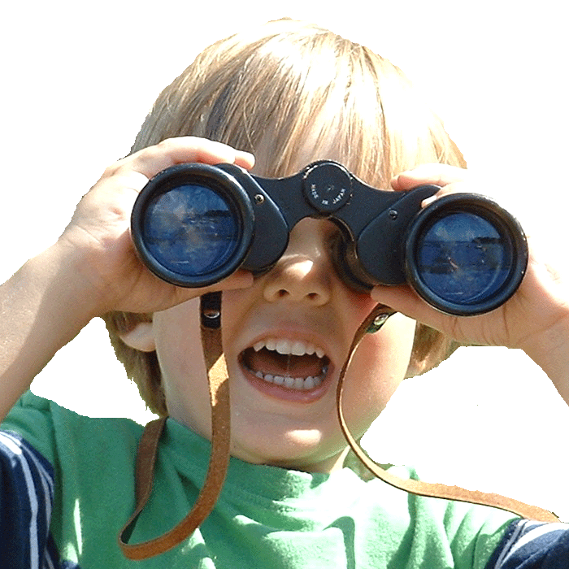
does school not what
________ can you see?
What

Slide 4
does school not what
Pam is _____ sad.
not

Slide 5
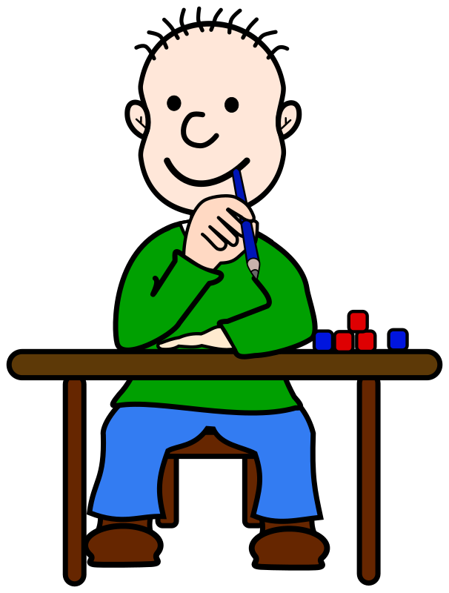
does school not what
He likes ___________.
school

Slide 6
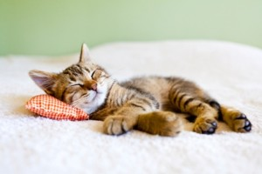
does school not what
_______ a cat nap?
Does

