Slide 1
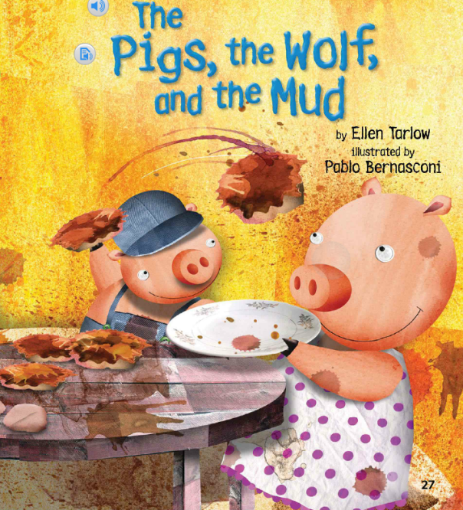
Unit 2 Week 2 Wonders- High Frequency Words
What building do you know? What are they made of?

Slide 2
Chant the word as it appears
could
live
then
three
one

Slide 3
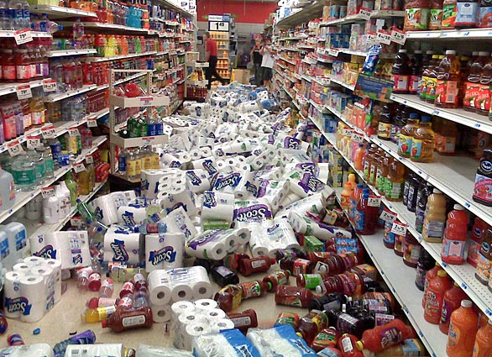
could live then three one
What did you do ____?
then

Slide 4
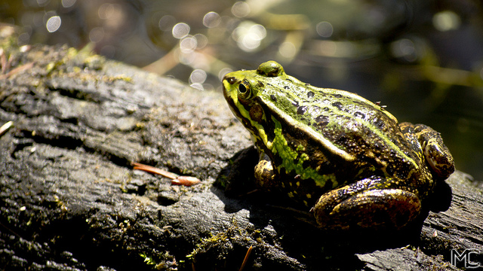
could live then three one
There is ____ frog on the log.
one

Slide 5
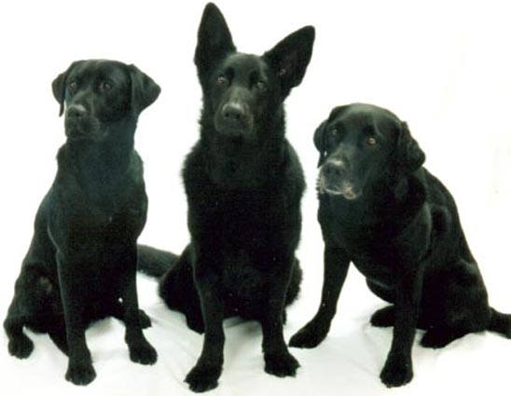
could live then three one
______ black dogs run in the grass.
Three

Slide 6
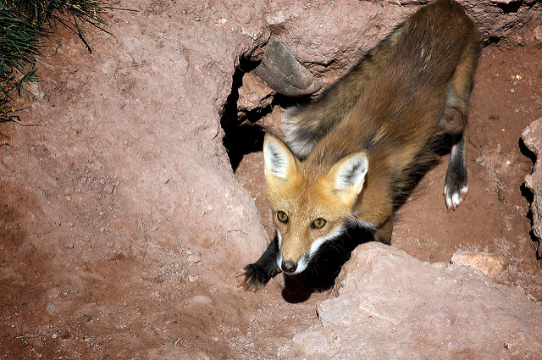
could live then three one
Does a fox ____ in a den?
live

Slide 7
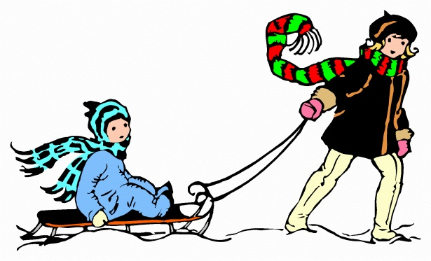
could live then three one
could
I _________ pull a big sled.

