Slide 1
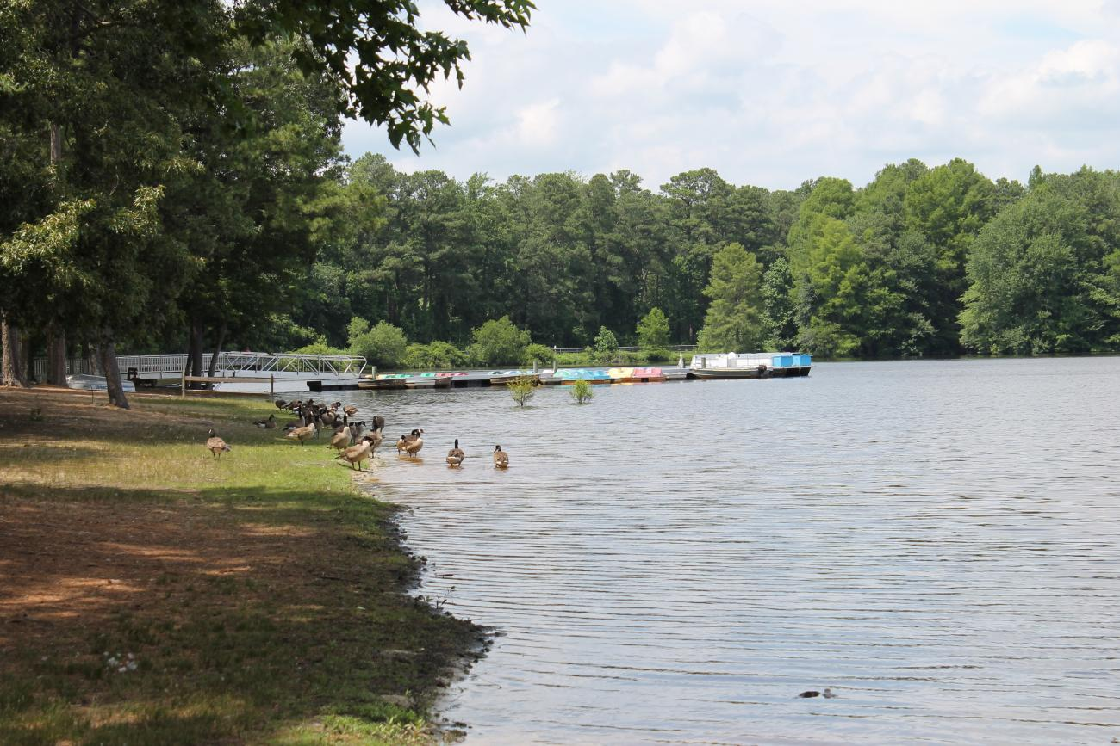
Unit 2 Week 3 Wonders- High Frequency Words
Where do animals live together?

Slide 2
Chant the word as it appears
eat
no
of
under
who

Slide 3
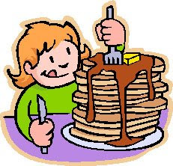
eat no of under who
What do you like to ____?
eat

Slide 4
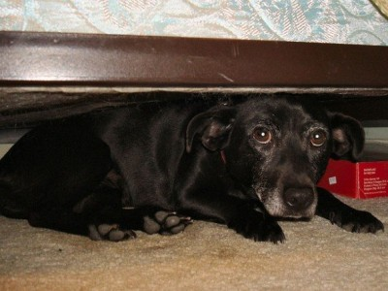
eat no of under who
The dog hid _____ the bed.
under

Slide 5
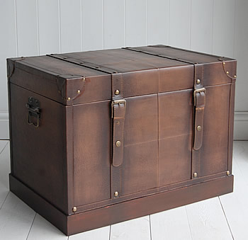
eat no of under who
The trunk has lots ___ stuff in it.
of

Slide 6
eat no of under who
______ is it?
Who

Slide 7
eat no of under who
No
____, you can eat that!

