Slide 1
Unit 5 Week 4 Wonders- High Frequency Words What sounds can you hear? How are they made?

Slide 2
Chant the word as it appears
color
early
instead
nothing
oh
thought

Slide 3
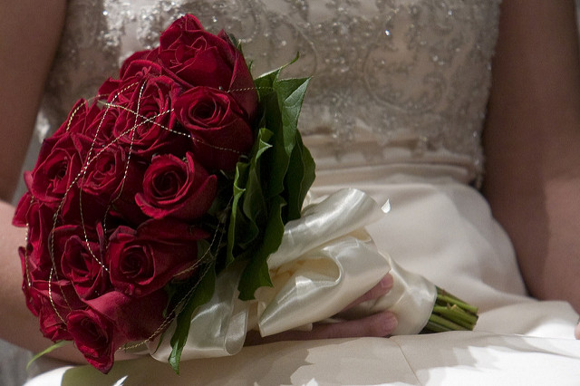
color early instead nothing oh thought
What ______ will her flowers be?
color

Slide 4
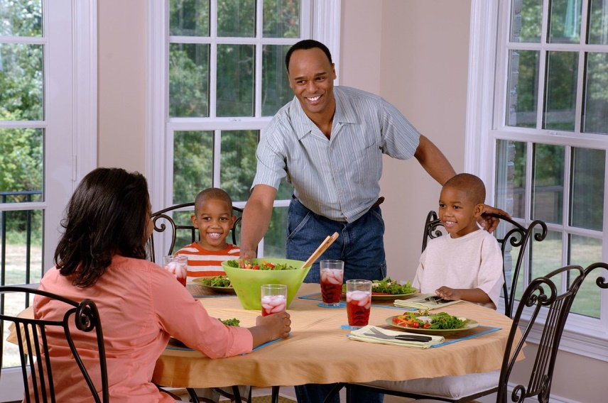
color early instead nothing oh thought
He _______ we should eat lunch now.
thought

Slide 5
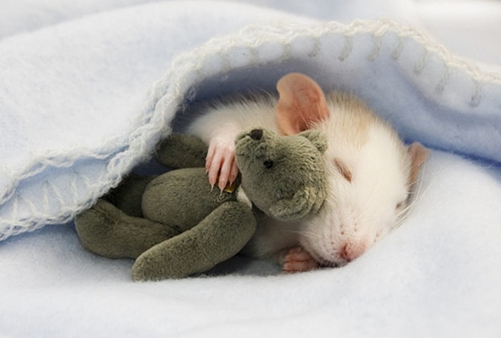
color early instead nothing oh thought
The mouse did not wake up ______.
early

Slide 6
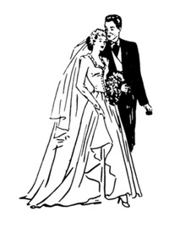
color early instead nothing oh thought
____, Miss Findlay will be a beautiful bride.
Oh

Slide 7
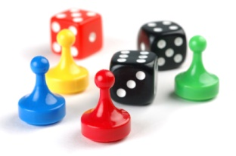
color early instead nothing oh thought
What do you want to do ______?
instead

Slide 8
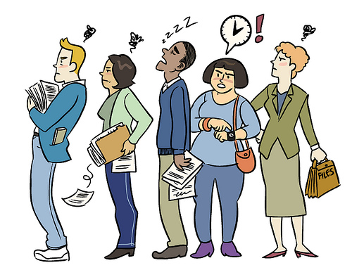
color early instead nothing oh thought
nothing
There is _______ to do while we wait.

