Slide 1
Unit 6 Week 1 Wonders- High Frequency Words How can we work together to make our lives better?

Slide 2
Chant the word as it appears
answer
brought
busy
door
enough
eyes

Slide 3
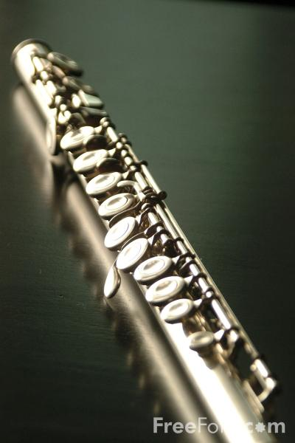
answer brought busy door enough eyes
Sam ______ his flute home from school.
brought

Slide 4
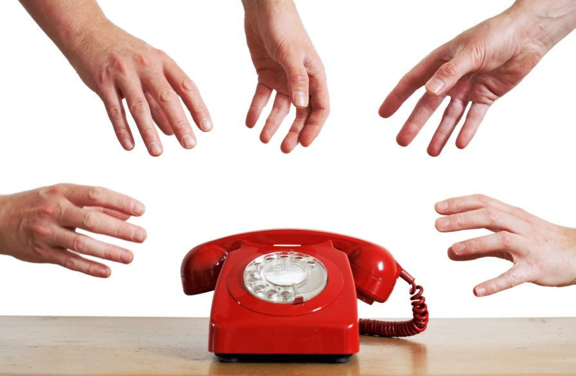
answer brought busy door enough eyes
Who will ______ the phone?
answer

Slide 5
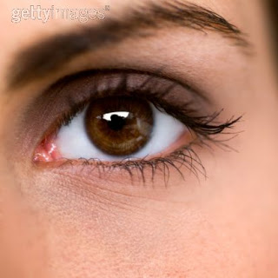
answer brought busy door enough eyes
My ____ are brown.
eyes

Slide 6
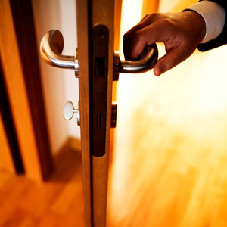
answer brought busy door enough eyes
Who opened the ____?
door

Slide 7
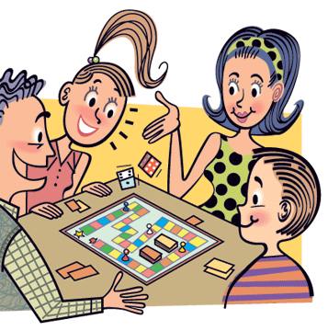
answer brought busy door enough eyes
enough
Do we have ______ time to play this game?

Slide 8
answer brought busy door enough eyes
We had a ______ day at school.
busy

