Slide 1
The Gingerbread Man
Unit 3, Week 3 Spelling Words
What is a folktale?

Slide 2
rice

Slide 3
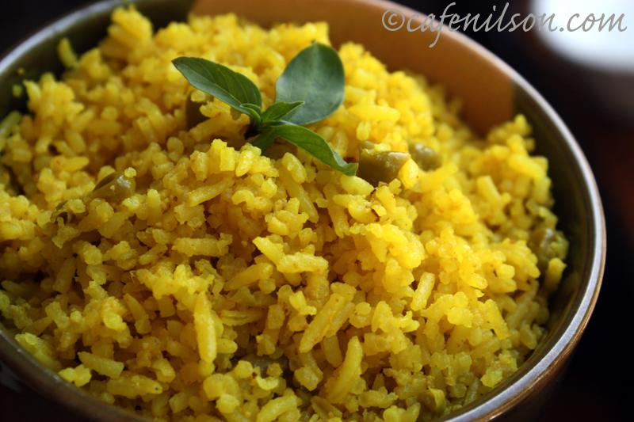
nice

Slide 4
page

Slide 5
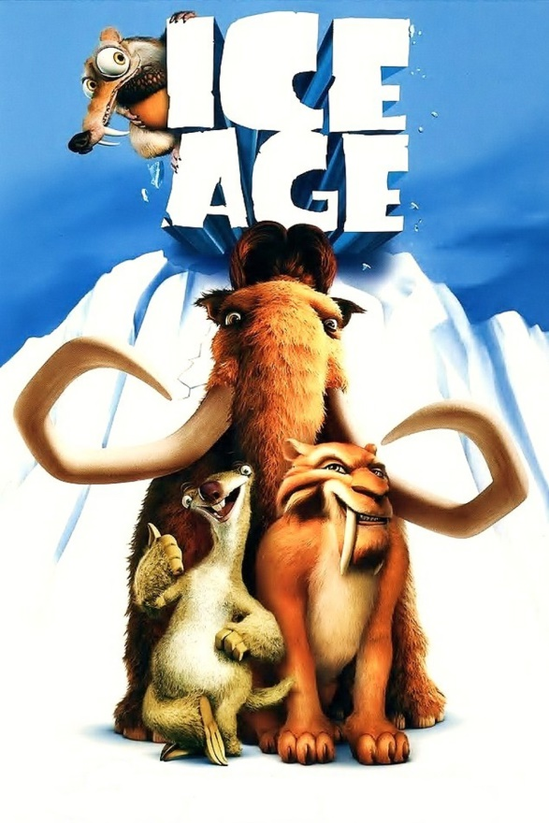
age

Slide 6
wedge

Slide 7
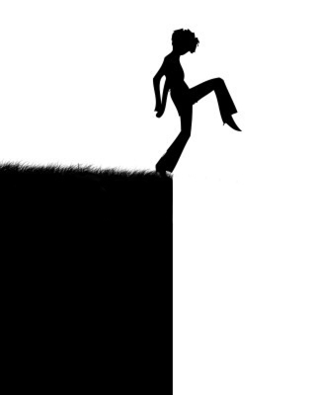
ledge

Slide 8
like

Slide 9
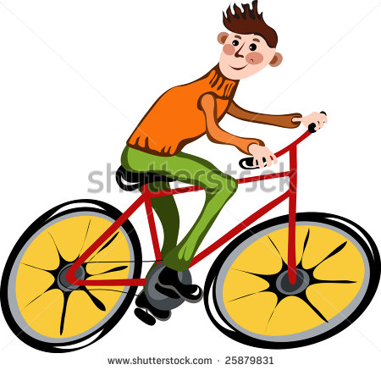
ride

Slide 10
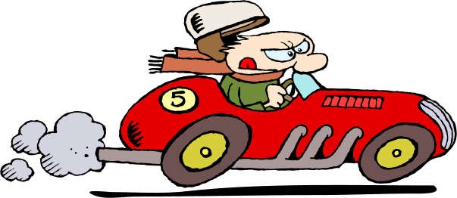
raced

Slide 11
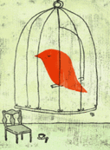
caged

Slide 12
High-Frequency Words
from
once

