Slide 1
Thomas Edison, Inventor
Unit 5, Week 3
What inventions do you know about?
Spelling Words

Slide 2
born

Slide 3
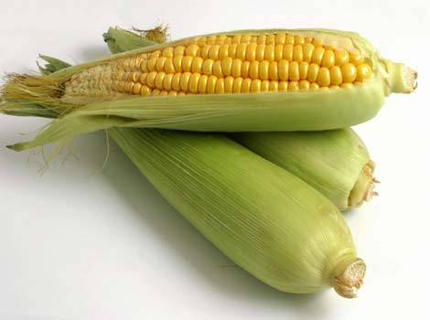
corn

Slide 4
more

Slide 5
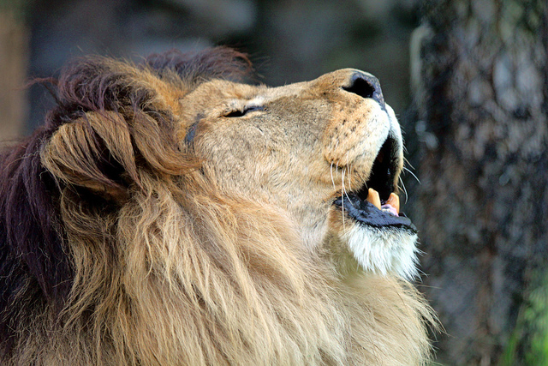
roar

Slide 6
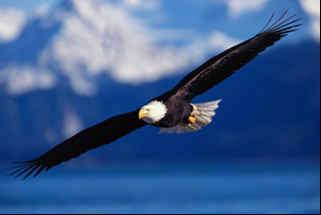
soar

Slide 7
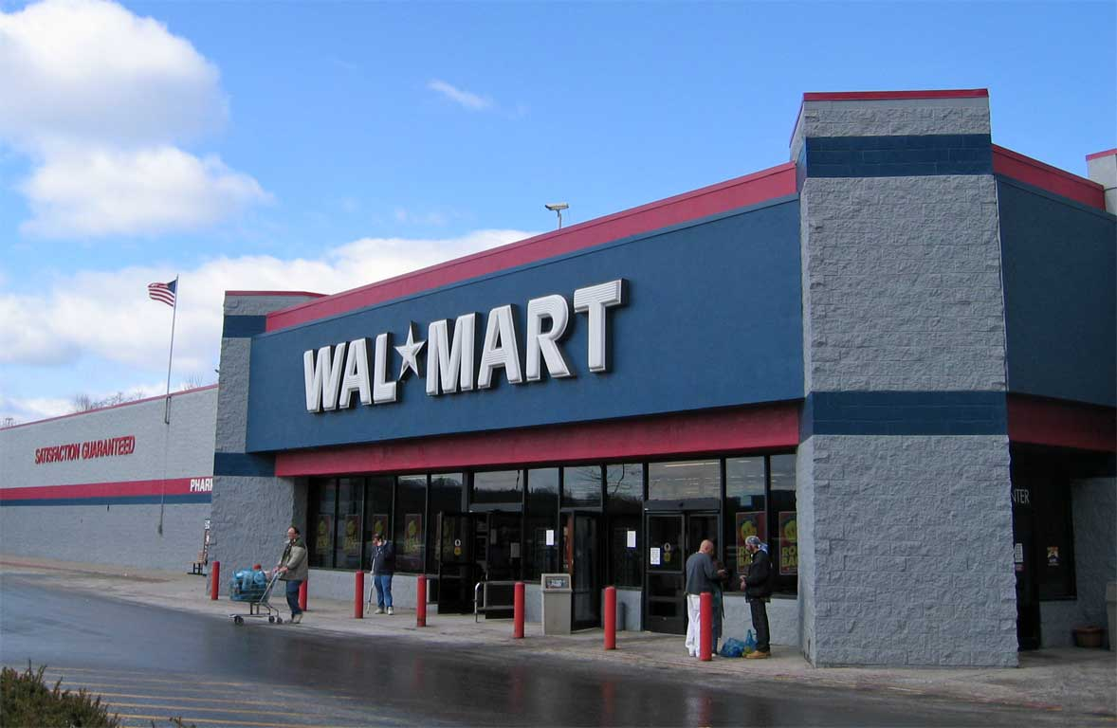
store

Slide 8
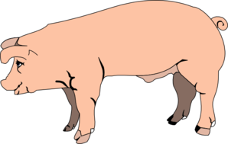
pork

Slide 9
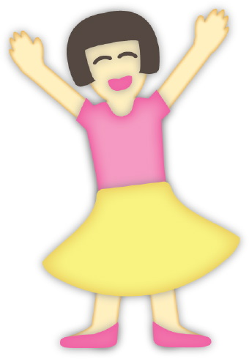
her

Slide 10
dirt

Slide 11
Challenge Words
learn
sure

